Slide 1


Khaled Youssef A. Hassoun
October 30, 2023

Slide 2

Outline
Executive Summary
Introduction
Methodology
Results
Conclusion
Appendix

Slide 3
Executive Summary
Summary of methodologies
Data Collection through API
Data Collection with Web Scraping
Data Wrangling
Exploratory Data Analysis with SQL
Exploratory Data Analysis with Data Visualization
Interactive Visual Analytics with Folium
Machine Learning Prediction
Summary of all results
Exploratory Data Analysis result
Interactive analytics in screenshots
Predictive Analytics result

Slide 4
Executive Summary(Cont.)
Collected data from public SpaceX API and SpaceX Wikipedia page. Created labels column ‘class’ which classifies successful landings. Explored data using SQL, visualization, folium maps, and dashboards. Gathered relevant columns to be used as features. Changed all categorical variables to binary using one hot encoding. Standardized data and used GridSearchCV to find best parameters for machine learning models. Visualize accuracy score of all models.
Four machine learning models were produced: Logistic Regression, Support Vector Machine, Decision Tree Classifier, and K Nearest Neighbors. All produced similar results with accuracy rate of about 83.33%. All models over predicted successful landings. More data is needed for better model determination and accuracy.

Slide 5
Introduction
Project background and context
Space X advertises Falcon 9 rocket launches on its website with a cost of 62 million dollars; other providers cost upward of 165 million dollars each, much of the savings is because Space X can reuse the first stage. Therefore, if we can determine if the first stage will land, we can determine the cost of a launch. This information can be used if an alternate company wants to bid against space X for a rocket launch. This goal of the project is to create a machine learning pipeline to predict if the first stage will land successfully.
Problems you want to find answers
What factors determine if the rocket will land successfully?
The interaction amongst various features that determine the success rate of a successful landing.
What operating conditions needs to be in place to ensure a successful landing program.

Slide 6

Section 1

Slide 7
Methodology
Executive Summary
Data collection methodology:
Data was collected using SpaceX API and web scrapping from Wikipedia.
Perform data wrangling
One-hot encoding was applied to categorical features
Perform exploratory data analysis (EDA) using visualization and SQL
Perform interactive visual analytics using Folium and Plotly Dash
Perform predictive analysis using classification models
How to build, tune, evaluate classification models

Slide 8
Data Collection
The data was collected using various methods
Data collection was done using get request to the SpaceX API.
Next, we decoded the response content as a Json using .json() function call and turn it into a pandas dataframe using .json_normalize().
We then cleaned the data, checked for missing values and fill in missing values where necessary.
In addition, we performed web scraping from Wikipedia for Falcon 9 launch records with BeautifulSoup.
The objective was to extract the launch records as HTML table, parse the table and convert it to a pandas dataframe for future analysis.

Slide 9
Data Collection(Cont.)
Data collection process involved a combination of API requests from Space X public API and web scraping data from a table in Space X’s Wikipedia entry.
The next slide will show the flowchart of data collection from API and the one after will show the flowchart of data collection from webscraping.
Space X API Data Columns:
FlightNumber, Date, BoosterVersion, PayloadMass, Orbit, LaunchSite, Outcome, Flights, GridFins,
Reused, Legs, LandingPad, Block, ReusedCount, Serial, Longitude, Latitude
Wikipedia Webscrape Data Columns:
Flight No., Launch site, Payload, PayloadMass, Orbit, Customer, Launch outcome, Version Booster, Booster landing, Date, Time

Slide 10
Data Collection – SpaceX API
I used the get request to the SpaceX API to collect data, clean the requested data and did some basic data wrangling and formatting.
The link to the notebook is https://github.com/Kyahpoots/Applied-Data-Science-Capstone/blob/main/Data%20Collection%20API.ipynb
Request (Space X APIs)
Filter data to only include Falcon 9 launches
Imputate missing PayloadMass values with mean
.JSON file + Lists(Launch Site, Booster Version, Payload Data)
Cast dictionary to a DataFrame
Json_normalize to DataFrame data from JSON
Dictionary
Relevant data

Slide 11


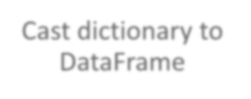


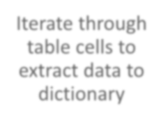




Data Collection - Scraping
I applied web scrapping to web scrap Falcon 9 launch records with BeautifulSoup
I parsed the table and converted it into a pandas dataframe.
The link to the notebook is https://github.com/Kyahpoots/Applied-Data-Science-Capstone/blob/main/Webscrapping.ipynb
Request Wikipedia
html
Cast dictionary to DataFrame
Iterate through table cells to extract data to dictionary
BeautifulSoup
html5lib Parser
Find launch info html table
Create dictionary

Slide 12

Data Wrangling
I performed exploratory data analysis and determined the training labels where successful=1 and failure=0.
I calculated the number of launches at each site, and the number and occurrence of each orbits
I created landing outcome label from outcome column and exported the results to csv.
The link to the notebook is https://github.com/Kyahpoots/Applied-Data-Science-Capstone/blob/main/Data%20Wrangling.ipynb

Slide 13
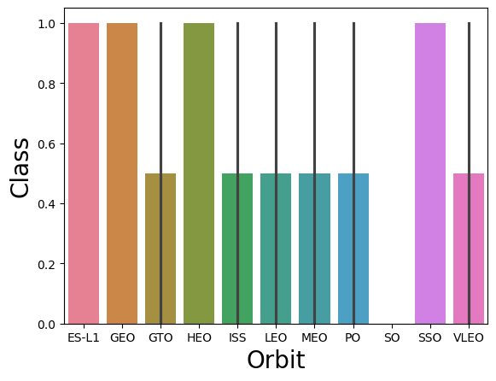
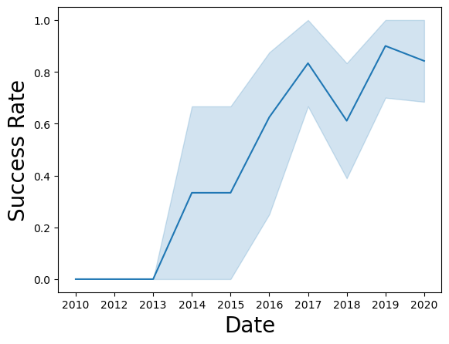
EDA with Data Visualization
I explored the data by visualizing the relationship between flight number and launch Site, payload and launch site, success rate of each orbit type, flight number and orbit type, the launch success yearly trend.

Slide 14
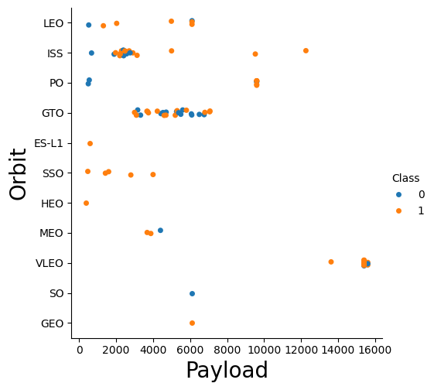
EDA with Data Visualization(Cont.)
Plots Used:
Flight Number vs. Payload Mass, Flight Number vs. Launch Site, Payload Mass vs. Launch Site, Orbit vs. Success Rate, Flight Number vs. Orbit, Payload vs Orbit, and Success Yearly Trend
Scatter plots, line charts, and bar plots I used to compare relationships between variables to decide if a relationship exists so that they could be used in training the machine learning model.
The link to the notebook is https://github.com/Kyahpoots/Applied-Data-Science-Capstone/blob/main/Data%20Visualiztaion.ipynb

Slide 15
EDA with SQL
I loaded the SpaceX dataset into the corresponding table in a Db2 Database.
Execute SQL queries using SQL Python Integration.
I applied EDA with SQL to get insight from the data. I wrote queries to find out for instance:
The names of unique launch sites in the space mission.
The total payload mass carried by boosters launched by NASA (CRS)
The average payload mass carried by booster version F9 v1.1
The total number of successful and failure mission outcomes
The failed landing outcomes in drone ship, their booster version and launch site names.
The link to the notebook is https://github.com/Kyahpoots/Applied-Data-Science-Capstone/blob/main/SQL%20Management.ipynb

Slide 16
Build an Interactive Map with Folium
Folium maps marks all launch sites, and added map objects such as markers, circles, lines to mark the success or failure of launches for each site on the folium map.
I assigned the feature launch outcomes (failure or success) to class 0 and 1.i.e., 0 for failure, and 1 for success.
Using the color-labeled marker clusters, I identified which launch sites have relatively high success rate.
We calculated the distances between a launch site to its proximities. I answered some question for instance:
Are launch sites near railways, highways and coastlines.
Do launch sites keep certain distance away from cities.
The link to the notebook is https://github.com/Kyahpoots/Applied-Data-Science-Capstone/blob/main/Exploratory%20Data%20Analysis.ipynb

Slide 17
Build a Dashboard with Plotly Dash
I built an interactive dashboard with Plotly dash
I plotted pie charts showing the total launches by a certain sites
I plotted scatter graph showing the relationship with Outcome and Payload Mass (Kg) for the different booster version.
Dashboard includes a pie chart and a scatter plot. Pie chart can be selected to show distribution of successful landings across all launch sites and can be selected to show individual launch site success rates.
Scatter plot takes two inputs: All sites or individual site and payload mass on a slider between 0 and 10000 kg. The scatter plot can help us see how success varies across launch sites, payload mass, and booster version category.
The link to the notebook is https://github.com/Kyahpoots/Applied-Data-Science-Capstone/blob/main/spacex_dash_app.py

Slide 18
Predictive Analysis (Classification)
I loaded the data using numpy and pandas, transformed the data, split our data into training and testing.
I built different machine learning models and tune different hyperparameters using GridSearchCV.
I used accuracy as the metric for our model, improved the model using feature engineering and algorithm tuning.
I found the best performing classification model.
The link to the notebook is https://github.com/Kyahpoots/Applied-Data-Science-Capstone/blob/main/Model%20Development.ipynb
Split label column
Score models on
Confusion Matrix
‘Class’ from dataset
split test set
for all models
Fit and Transform
Use GridSearchCV
Features using
on LogReg, SVM,
Barplot to compare scores of models
Standard Scaler
Decision Tree, and
KNN models
Train_test_split
GridSearchCV
data
(cv=10) to find optimal parameters

Slide 19
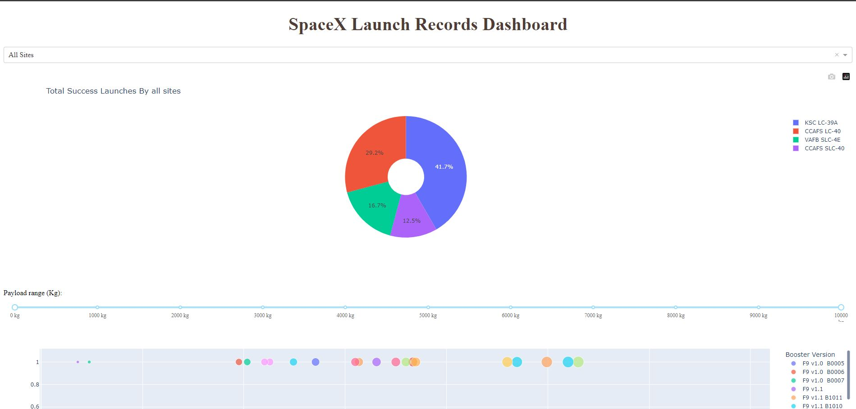
Results
This is a preview of the Plotly dashboard. The following sides will show the results of EDA with visualization, EDA with SQL, Interactive Map with Folium, and finally the results of our model with about 83% accuracy.

Slide 20

Section 2

Slide 21
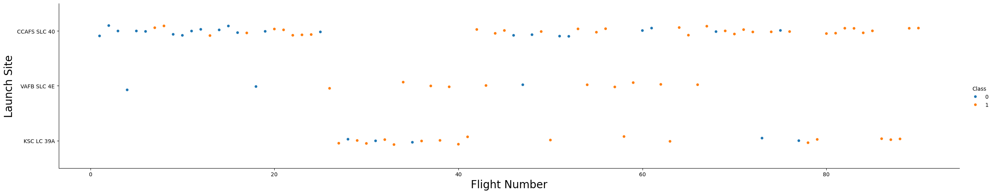
Flight Number vs. Launch Site
From the plot, we found that the larger the flight amount at a launch site, the greater the success rate at a launch site. CCAFS appears to be the main launch site as it has the most volume. Orange indicates successful launch; blue indicates unsuccessful launch.

Slide 22
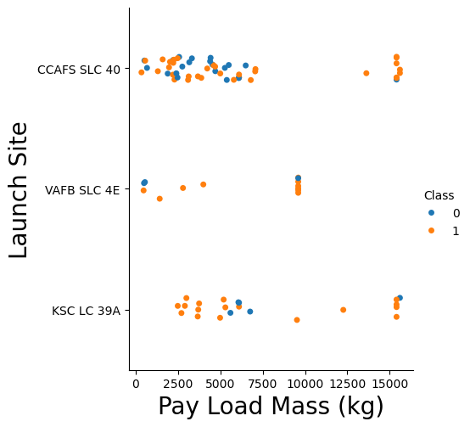
Payload vs. Launch Site
From the plot, the greater the payload mass for the launch site the higher the success rate for the rocket. Payload mass appears to fall mostly between 0-6000 kg. Different launch sites also seem to use different payload mass. Orange indicates successful launch; blue indicates unsuccessful launch.

Slide 23
Success Rate vs. Orbit Type
From the plot, we can see that ES-L1, GEO, HEO, SSO had the most success rate.
While GTO, ISS, LEO, MEO, PO, VLEO had 50% success rate

Slide 24
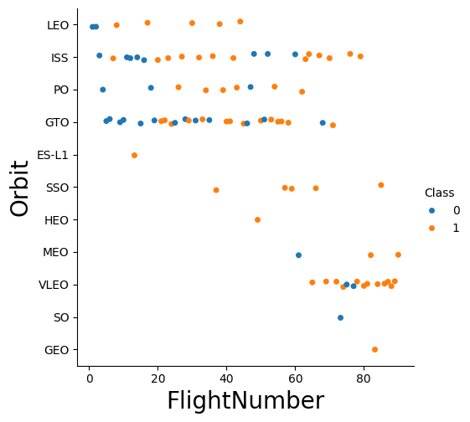
Flight Number vs. Orbit Type
The plot shows the Flight Number vs. Orbit type. We observe that in the LEO orbit, success is related to the number of flights whereas in the GTO orbit, there is no relationship between flight number and the orbit.
Launch Orbit preferences changed over Flight Number. Launch Outcome seems to correlate with this preference.

Slide 25
Payload vs. Orbit Type
We can observe that with heavy payloads, the successful landing are more for PO, LEO and ISS orbits.
Payload mass seems to correlate with orbit.
The most successful orbit is VLEO only has payload mass values in the higher end of the range.

Slide 26
Launch Success Yearly Trend
From the plot, we can observe that success rate generally increases over time since 2013 with a slight dip in 2018 kept on increasing till 2020.
Success in recent years at around 80%.

Slide 27
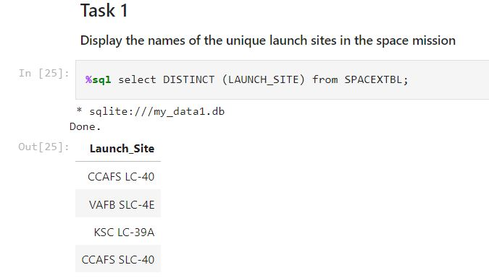
All Launch Site Names
I used the key word DISTINCT to show only unique launch sites from the SpaceX data.

Slide 28
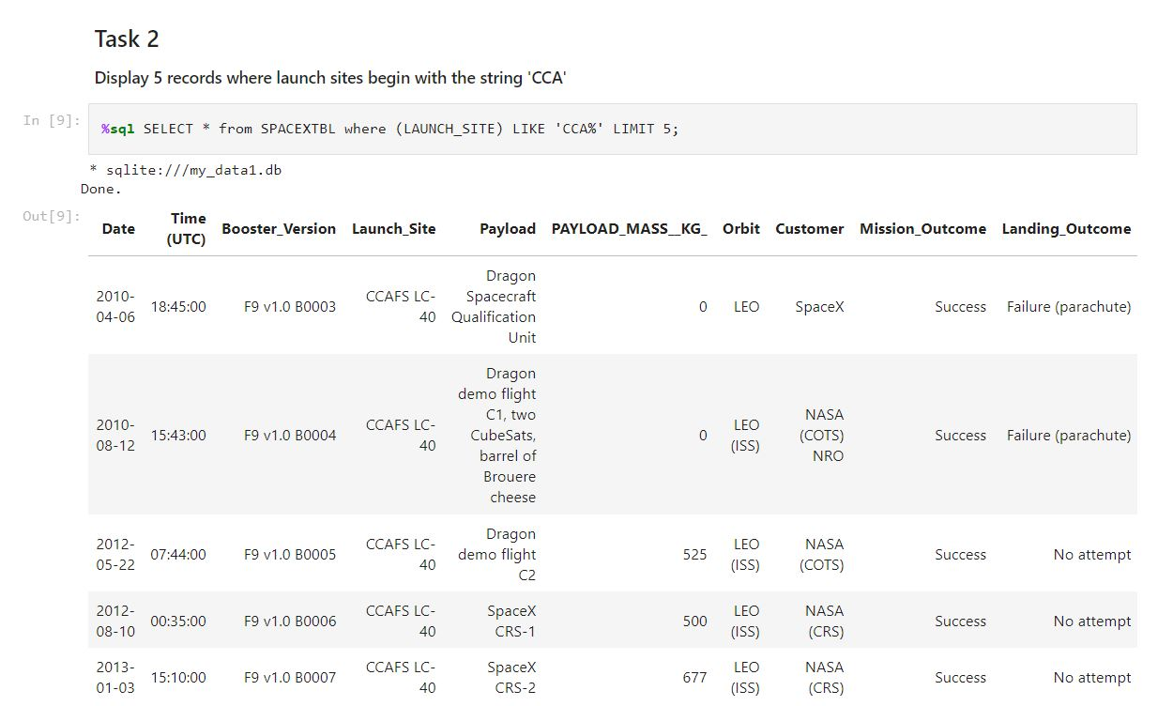
Launch Site Names Begin with 'CCA'
I used the query above to display 5 records where launch sites begin with `CCA`

Slide 29
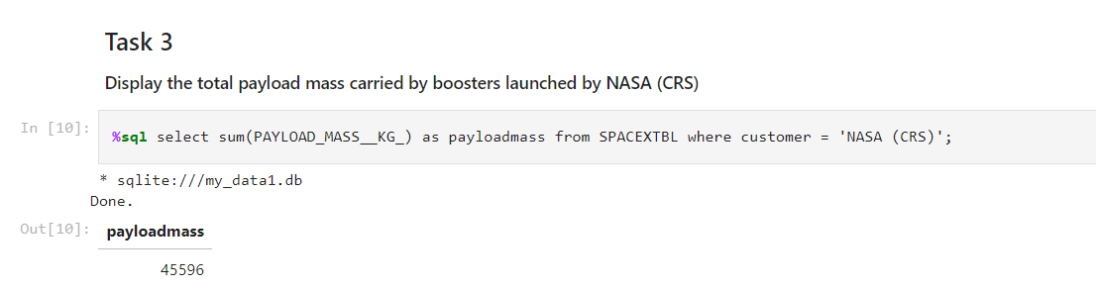
Total Payload Mass
This query sums the total payload mass in kg. I calculated the total payload carried by boosters from NASA as 45596.

Slide 30
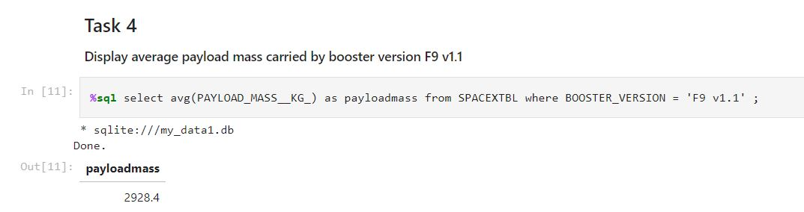
Average Payload Mass by F9 v1.1
I calculated the average payload mass carried by booster version F9 v1.1 as 2928.4
This query calculates the average payload mass or launches which used booster version F9 v1.1
Average payload mass of F9 1.1 is on the low end of our payload mass range

Slide 31
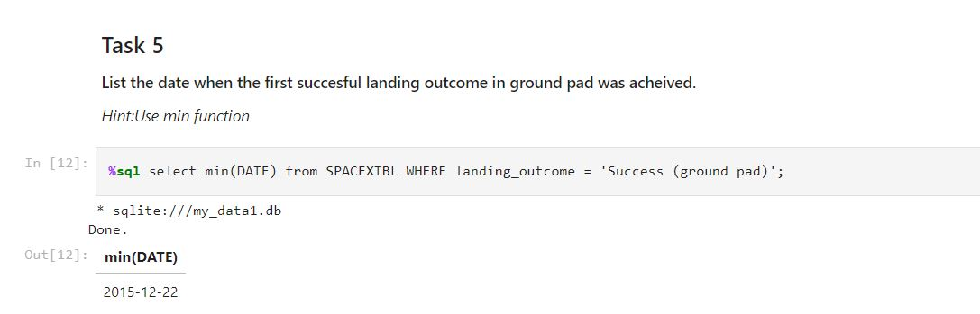
First Successful Ground Landing Date
We observed that the dates of the first successful landing outcome on ground pad was 22nd December 2015
This query returns the first successful ground pad landing date.
First ground pad landing wasn’t until the end of 2015.
Successful landings in general appear starting 2014.

Slide 32
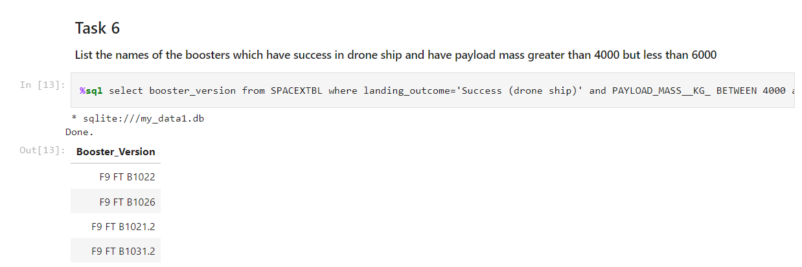
Successful Drone Ship Landing with Payload between 4000 and 6000
I used the query WHERE clause to filter for booster versions which have successfully landed on drone ship and applied the AND condition to determine successful landing with payload mass greater than 4000 but less than 6000.

Slide 33
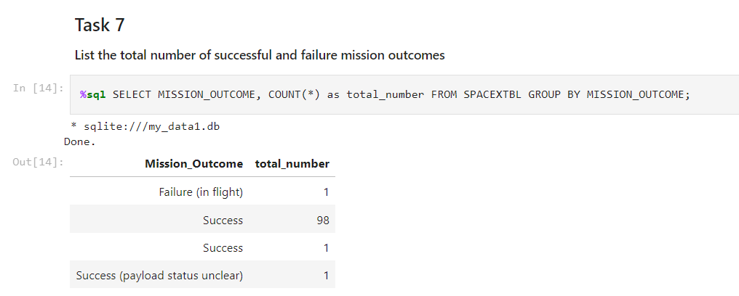
Total Number of Successful and Failure Mission Outcomes
This query returns a count of each mission outcome.
SpaceX appears to achieve its mission outcome nearly 99% of the time.
This means that most of the landing failures are intended.
Interestingly, one launch has an unclear payload status and unfortunately one failed in flight.

Slide 34
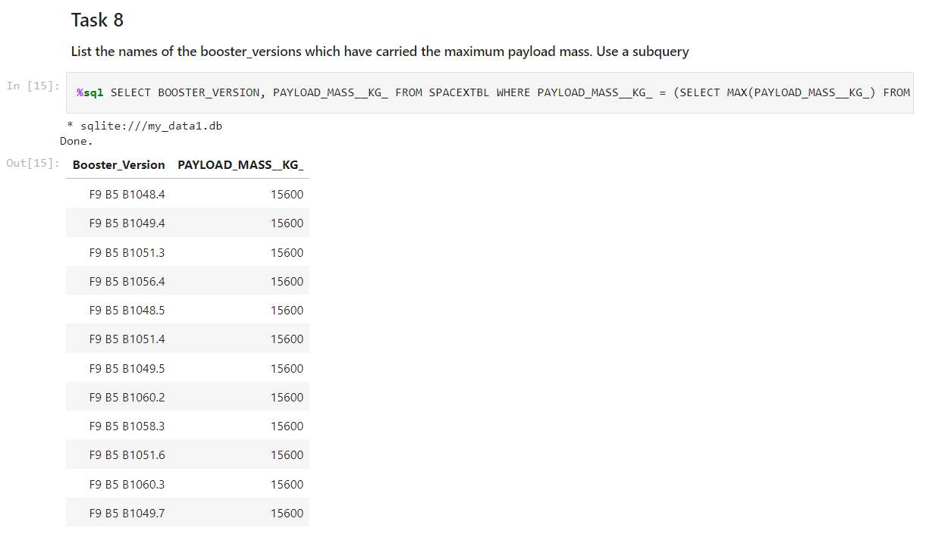
Boosters Carried Maximum Payload
This query returns the booster versions that carried the highest payload mass of 15600 kg.
These booster versions are very similar and all are of the F9 B5 B10xx.x variety.
This likely indicates payload mass correlates with the booster version that is used.
I determined the booster that have carried the maximum payload using a subquery in the WHERE clause and the MAX() function.

Slide 35
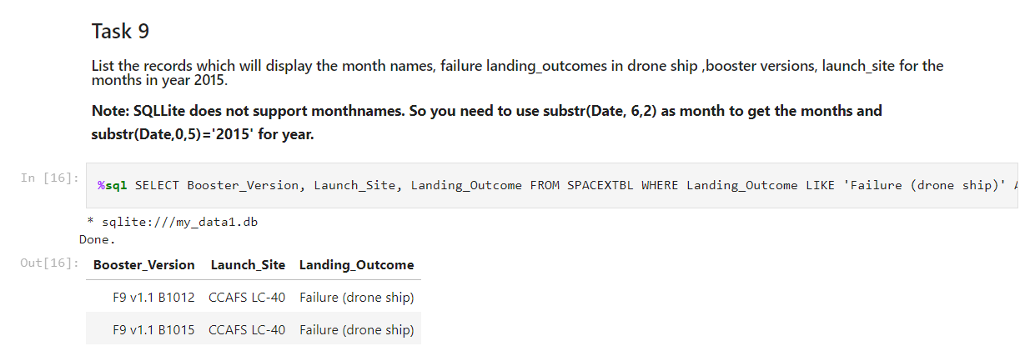
2015 Launch Records
I used a combinations of the WHERE clause, LIKE, AND, and BETWEEN conditions to filter for failed landing outcomes in drone ship, their booster versions, and launch site names for year 2015
This query returns the Booster Version, Landing Outcome, and Launch site of 2015 launches where stage 1 failed to land on a drone ship.
There were two such occurrences.

Slide 36
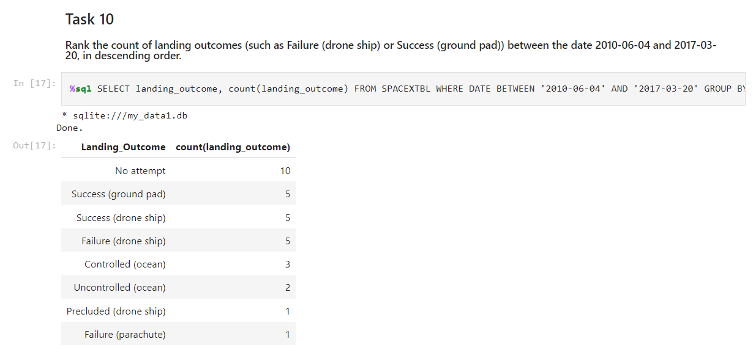
Rank Landing Outcomes Between 2010-06-04 and 2017-03-20
We selected Landing outcomes and the COUNT of landing outcomes from the data and used the WHERE clause to filter for landing outcomes BETWEEN 2010-06-04 to 2017-03-20.
We applied the GROUP BY clause to group the landing outcomes and the ORDER BY clause to order the grouped landing outcome in descending order.

Slide 37

Section 3

Slide 38

All launch sites global map markers

Slide 39

Markers showing launch sites with color labels

Slide 40

Launch Site distance to landmarks

Slide 41

Section 4

Slide 42

Pie chart showing the success percentage achieved by each launch site

Slide 43

Pie chart showing the Launch site with the highest launch success ratio

Slide 44

Scatter plot of Payload vs Launch Outcome for all sites, with different payload selected in the range slider

Slide 45

Section 5

Slide 46

Classification Accuracy
The decision tree classifier is the model with the highest classification accuracy

Slide 47

Confusion Matrix
The confusion matrix for the decision tree classifier shows that the classifier can distinguish between the different classes. The major problem is the false positives .i.e., unsuccessful landing marked as successful landing by the classifier.

Slide 48
Conclusions
We can conclude that:
The larger the flight amount at a launch site, the greater the success rate at a launch site. Launch success rate started to increase in 2013 till 2020. Orbits ES-L1, GEO, HEO, SSO, VLEO had the most success rate. KSC LC-39A had the most successful launches of any sites. The Decision tree classifier is the best machine learning algorithm for this task.
Our task: to develop a machine learning model for Space Y who wants to bid against SpaceX
The goal of model is to predict when Stage 1 will successfully land to save ~$100 million USD
Used data from a public SpaceX API and web scraping SpaceX Wikipedia page
Created data labels and stored data into a DB2 SQL database
Created a dashboard for visualization
We created a machine learning model with an accuracy of 83%
Allon Mask of SpaceY can use this model to predict with relatively high accuracy whether a launch will have a successful Stage 1 landing before launch to determine whether the launch should be made or not
If possible, more data should be collected to better determine the best machine learning model and improve accuracy

Slide 49
Appendix
GitHub repository url:
https://github.com/Kyahpoots/Applied-Data-Science-Capstone/
Special Thanks to all The Instructors:
Instructors: Dr. Pooja, Romeo Kienzler, Joseph Santacangelo, Polong Lin, Alex Aklson, Rav Ahuja, Saishruthi Swaminathan, Saeed Aghabozorgi, Hima Vasudevan, Azim Hirjani, Aije Egwaikhide, Yan Luo, Svetlana Levitan
https://coursera.org/professional-certificates/ibm-data-science

Slide 50


